Slide 2
Attributes
Some additional attributes including contingent liability to total assets, net worth to capital employed ratio, current ratio etc. turned out to be statistically insignificant predictors.
The model provided 94% accuracy in 30% validation data.
Notes:
We have run a logistic regression with this attributes to determine the probabilities of a possible default

Slide 3
Outcome from Fundamental Analysis
As per the outcome of regression analysis, the top six stocks are Apple, Boeing, Microsoft, Johnson & Johnson, IBM and Procter & Gamble

Slide 4
Recommendation
We may create a portfolio with the stocks which are recommended based on both the sentiment analysis as well as fundamental analysis.

Slide 5
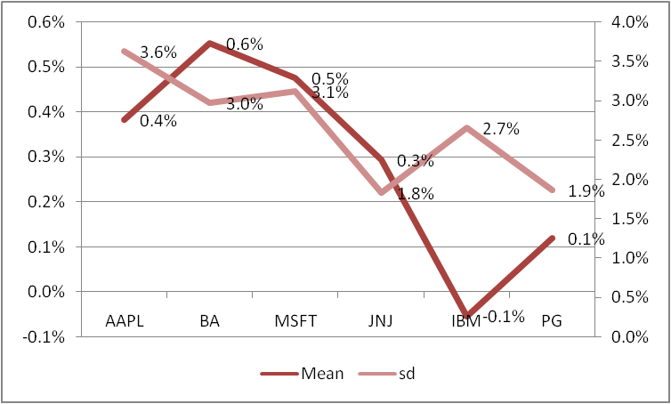
Portfolio Optimization
Mean and Standard Deviation

Slide 6
Portfolio Optimization
Covariance Matrix
Notes:
Lower the covariance, better is the prospect of risk and return optimization in a portfolio

Slide 7
Portfolio Optimization
Risk Optimization
We have minimized the portfolio risk with the target to achieve 0.3% weekly return on portfolio – and following is the result:
Minimized Portfolio Risk = 0.02%

Slide 8
Portfolio Optimization
Return Optimization
Alternatively, we have maximized the portfolio return with the target to limit the risk at 0.03% on portfolio – and following is the result:
Maximized Portfolio Return = 0.40%

Slide 9
Portfolio Optimization
Comparison of risk-return profile

